Slide 1
What are the differences?
Vamos para a Escola!

Slide 2
Hello!
I'm Professor Tomé and I'm the teacher of 1st C.

Slide 3
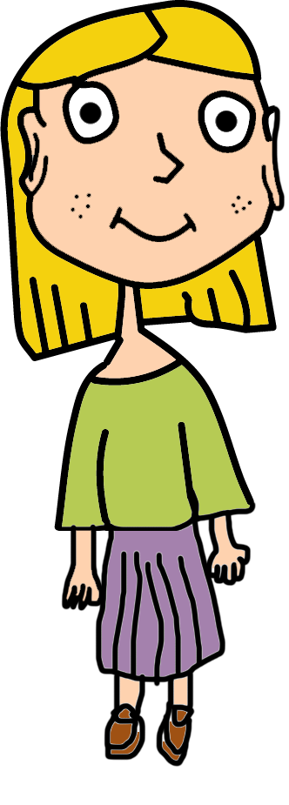
Hello!
I'm Professor Carla and I'm a teacher at
Orange Room!

Slide 4
Together we will discover the real differences between the two classrooms!
Are you ready?

Slide 5
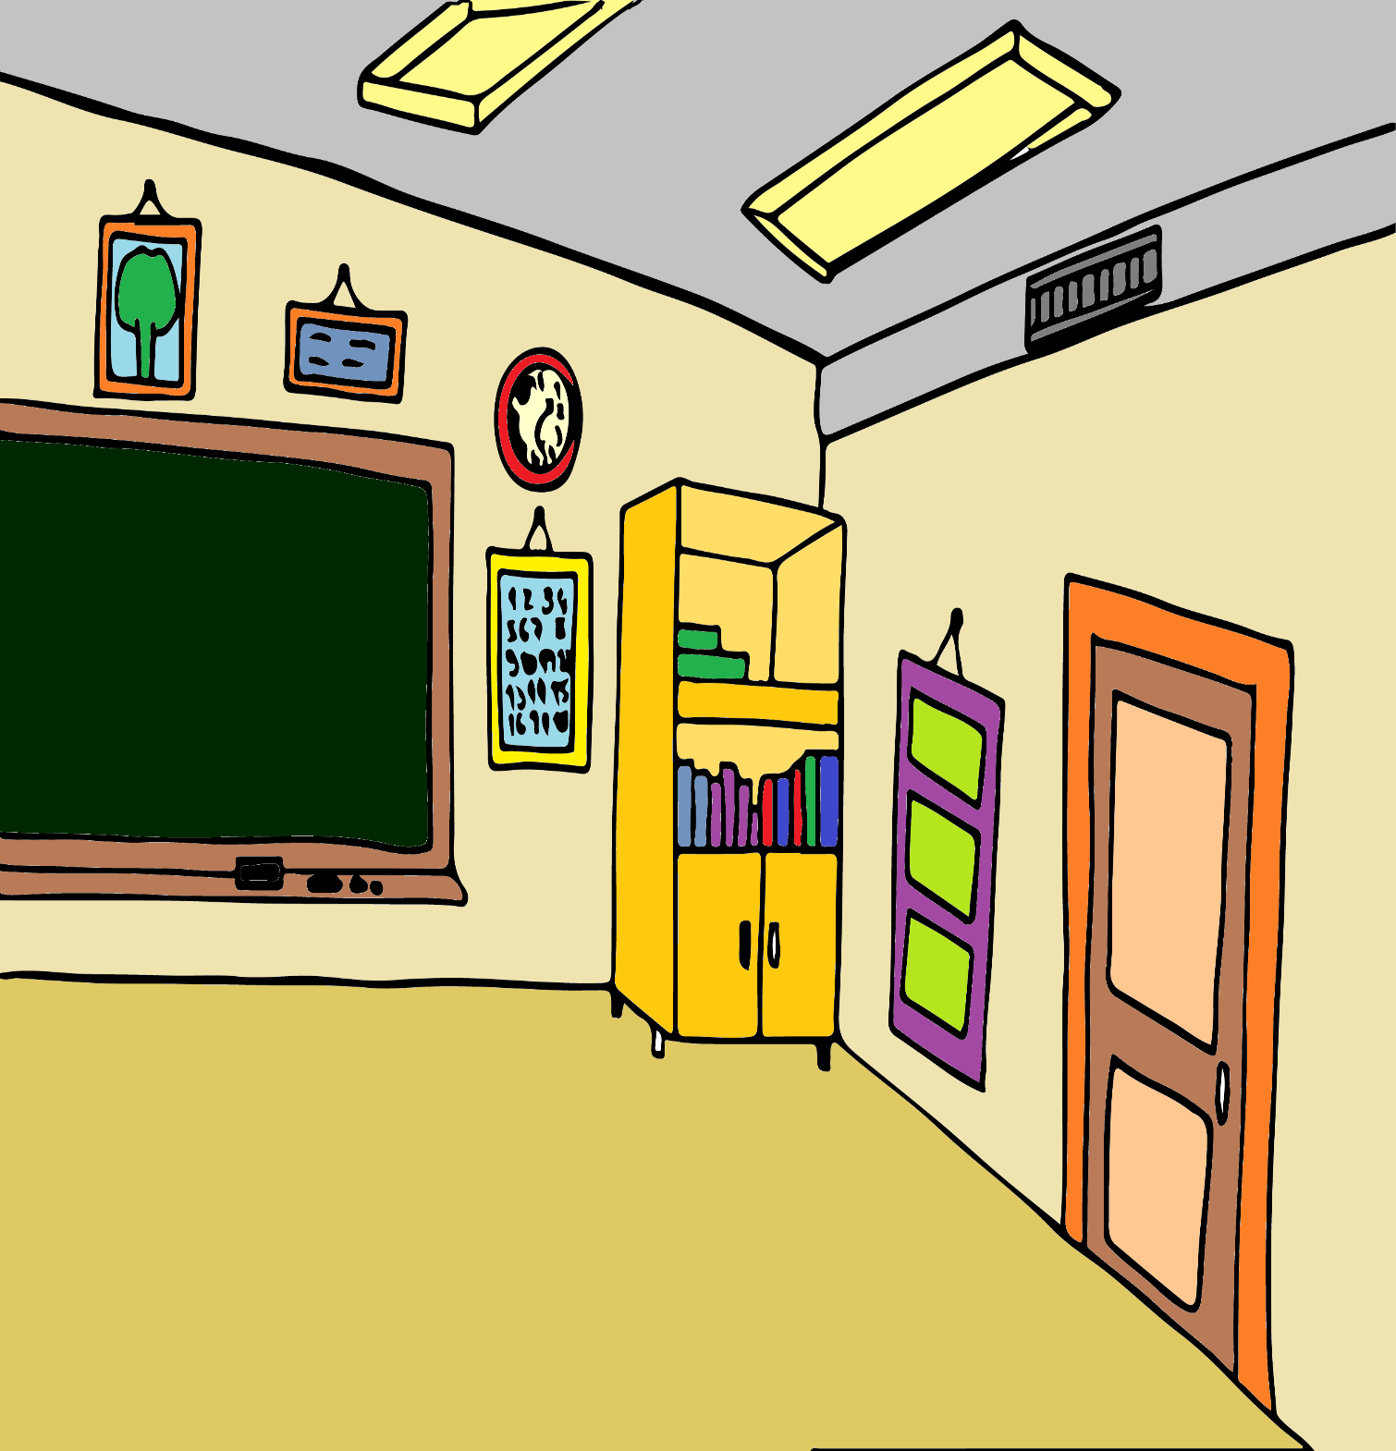
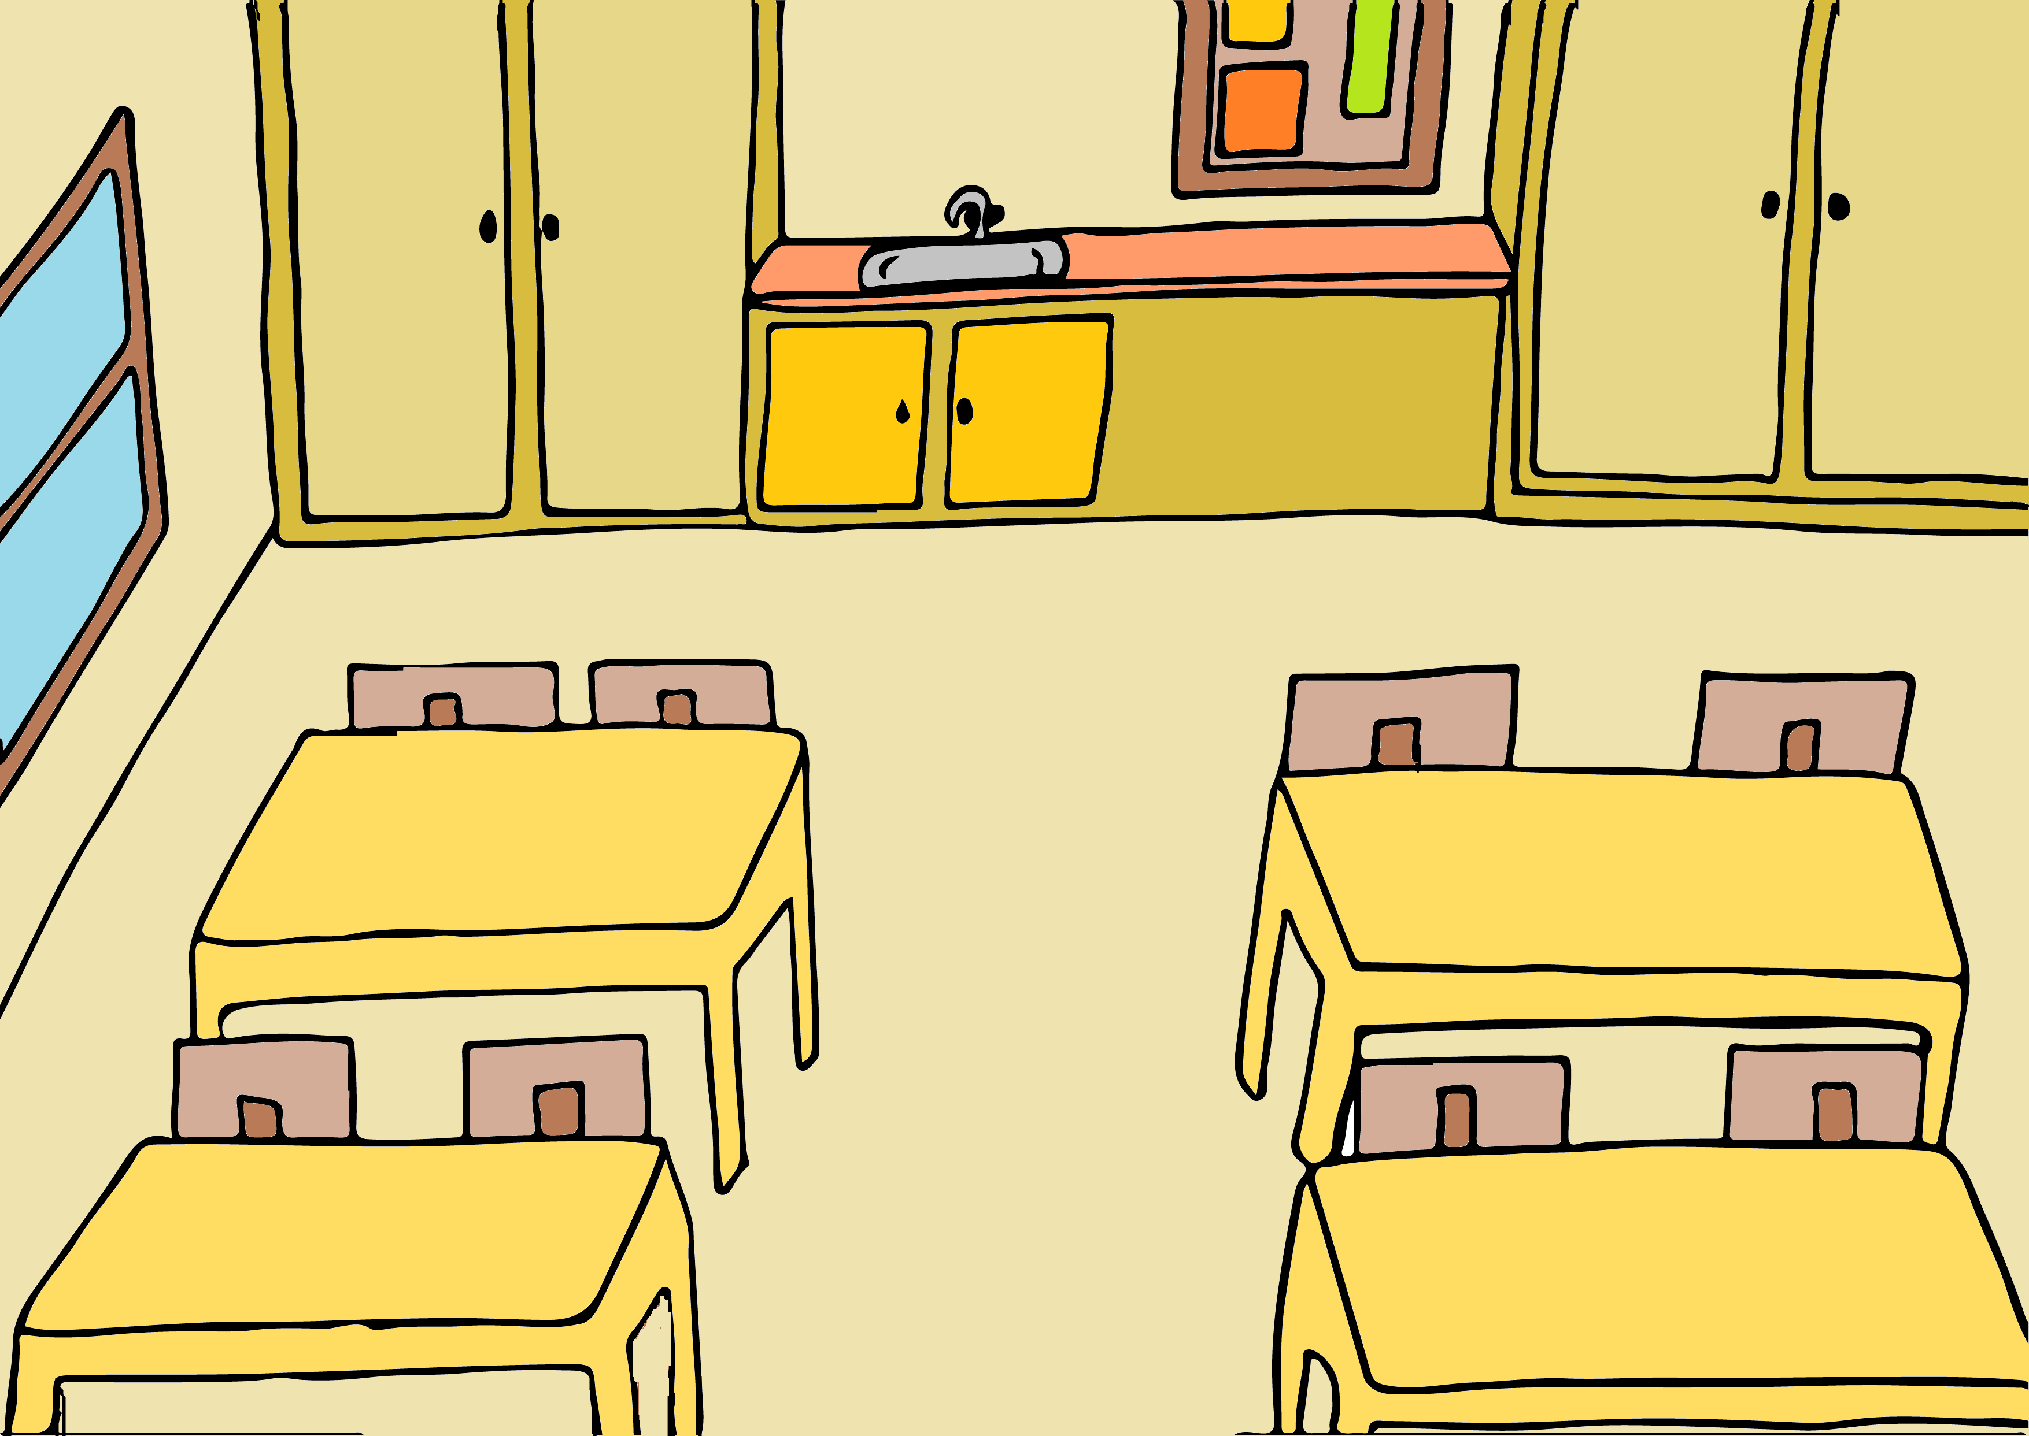
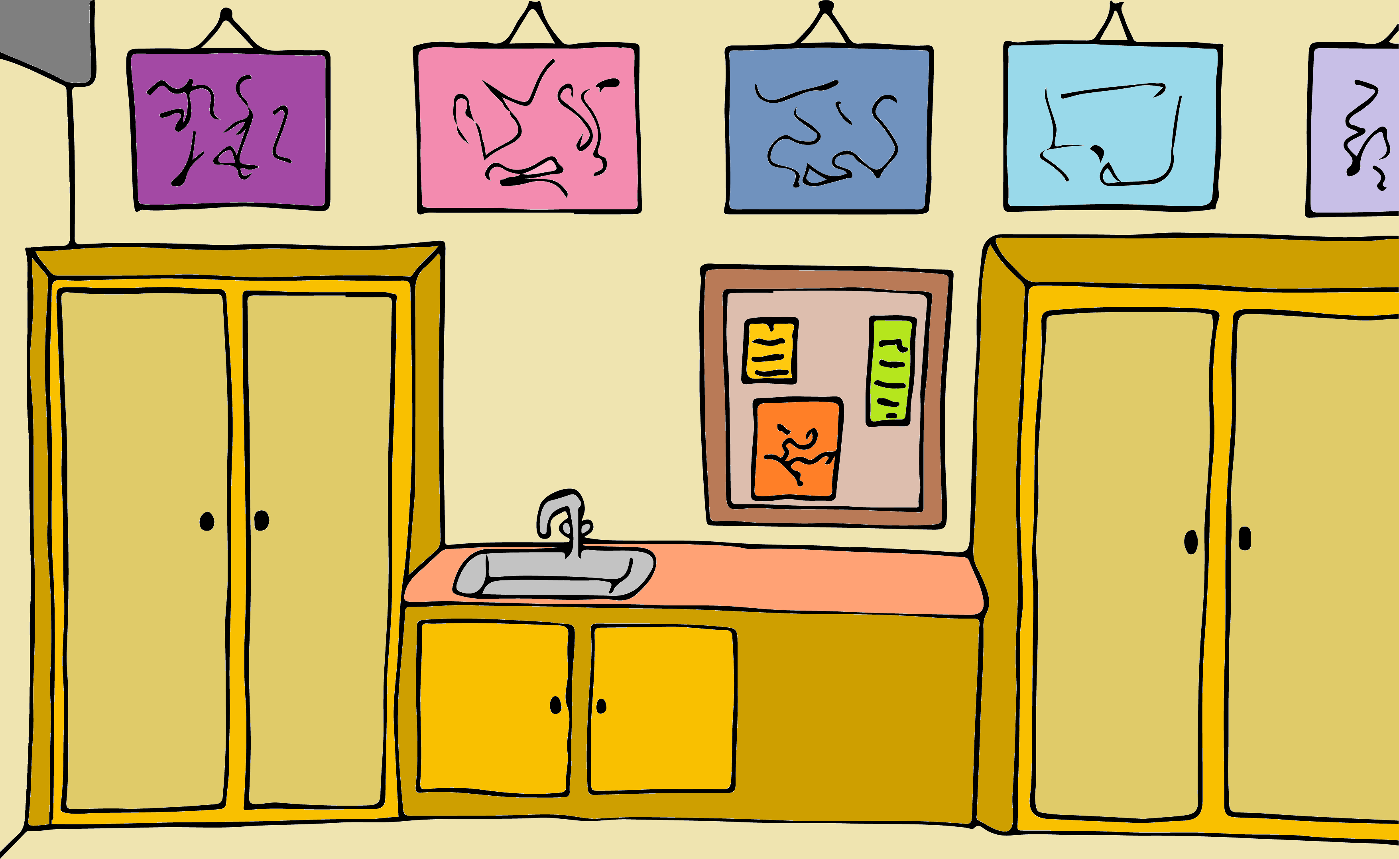
This is my classroom, mine and my students'...
It's very special because it's where all the magic of learning happens!

Slide 6
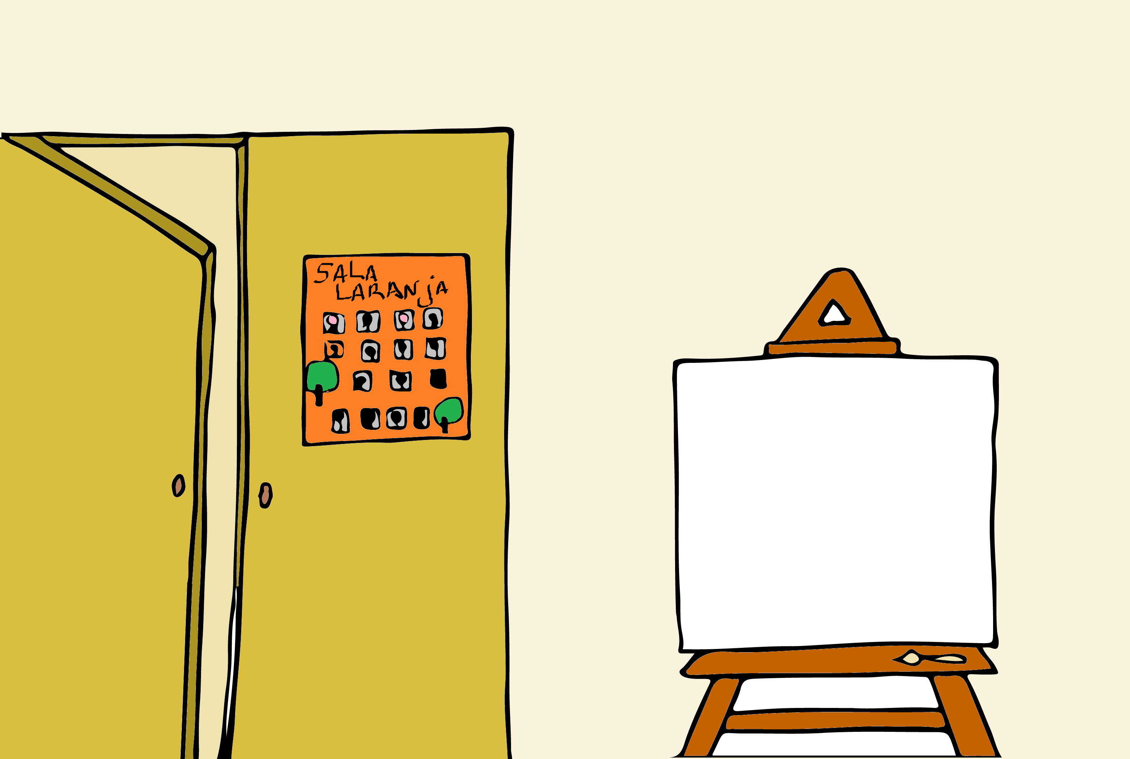
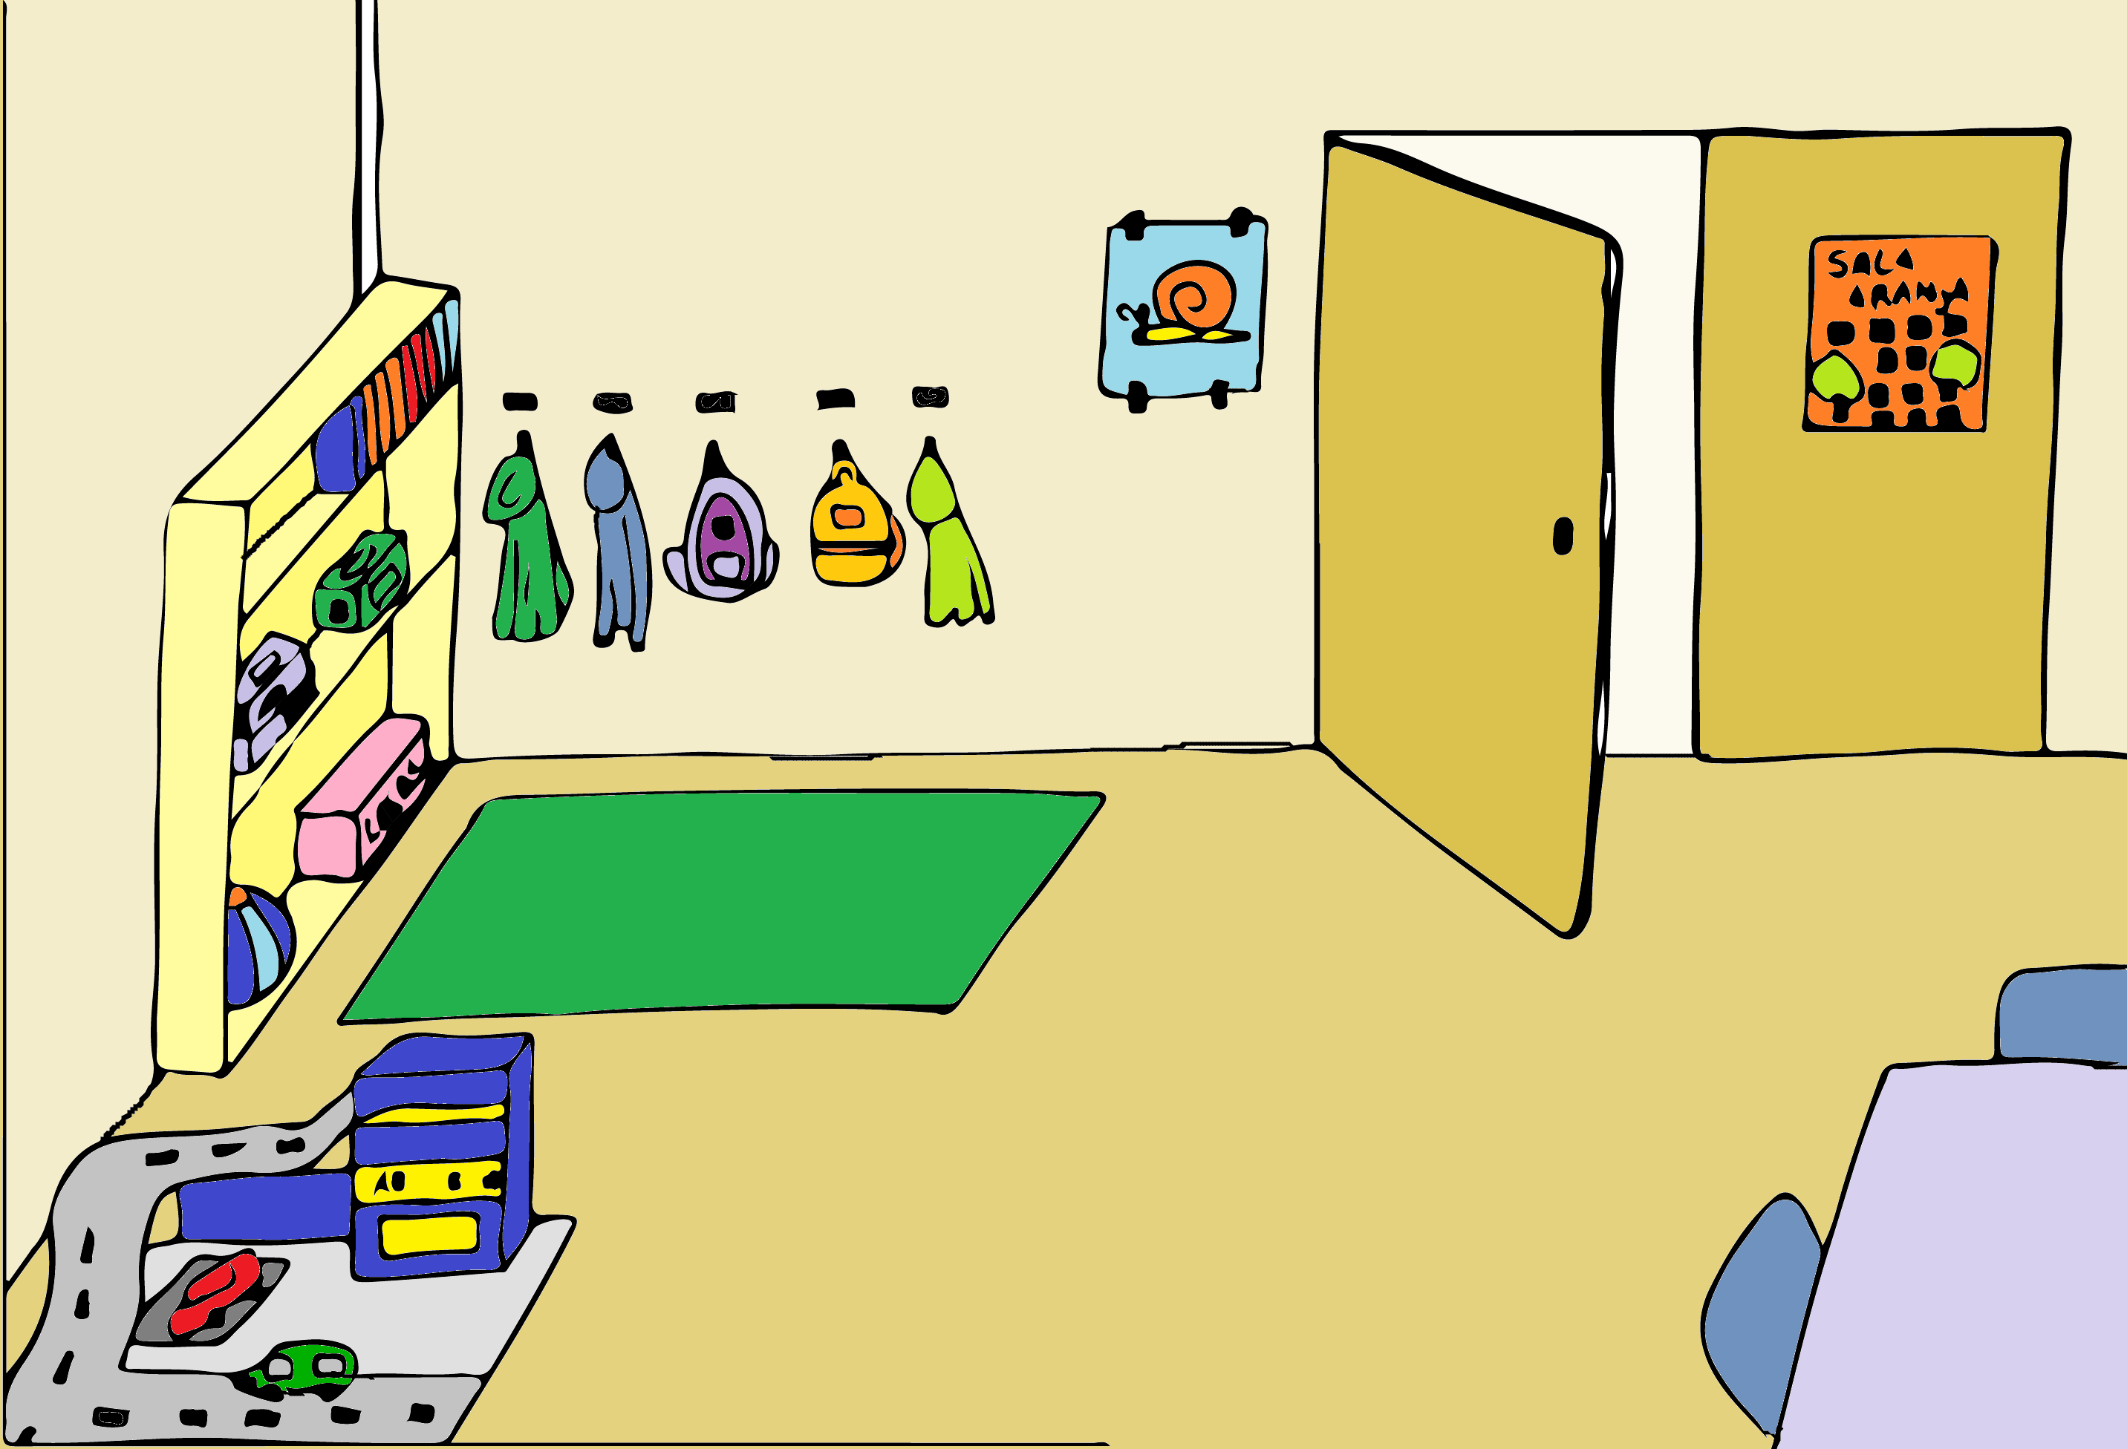
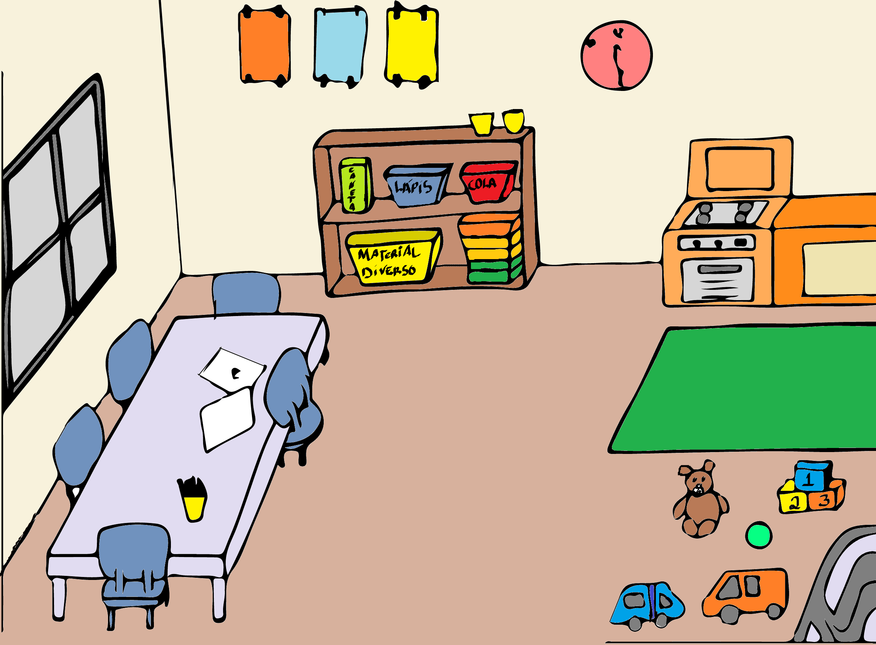
This is the orange room, a special room too!
Here the boys paint, play and learn a lot of things before they go to the first year.

Slide 7
Now that you know both classrooms, let's play
Difference Game!
That's right... Let's find the different objects in the 1st C room and the orange room!

Slide 8
FIND THE DIFFERENCE!
The teachers will help you with several clues about the different objects.
Press the object and see what happens!
Good Luck!

Slide 9
1ºst Clue
In it I will write for you to see and learn!

Slide 11
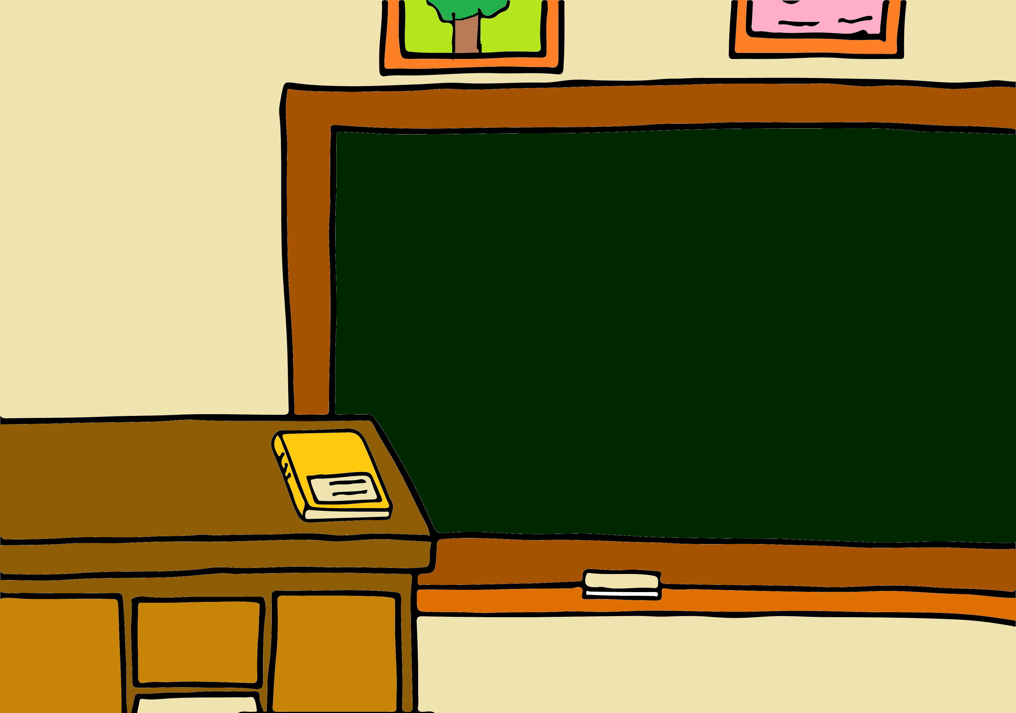
The blackboard…
In the first year's class there's a big, chalkboard where the teacher writes everything that's important! Students can also write on it when the teacher asks.
Dia 12 de Maio, 2020
Sumário:
- Jogo das diferenças nas salas;

Slide 12
2ºnd Clue
A brush you will use and an artist you will become!

Slide 14
The painting place!
In the orange room there is a canvas, where the students paint, on painting day.

Slide 15
3ºrd Clue
In it you will learn and throughout the class remain!

Slide 16
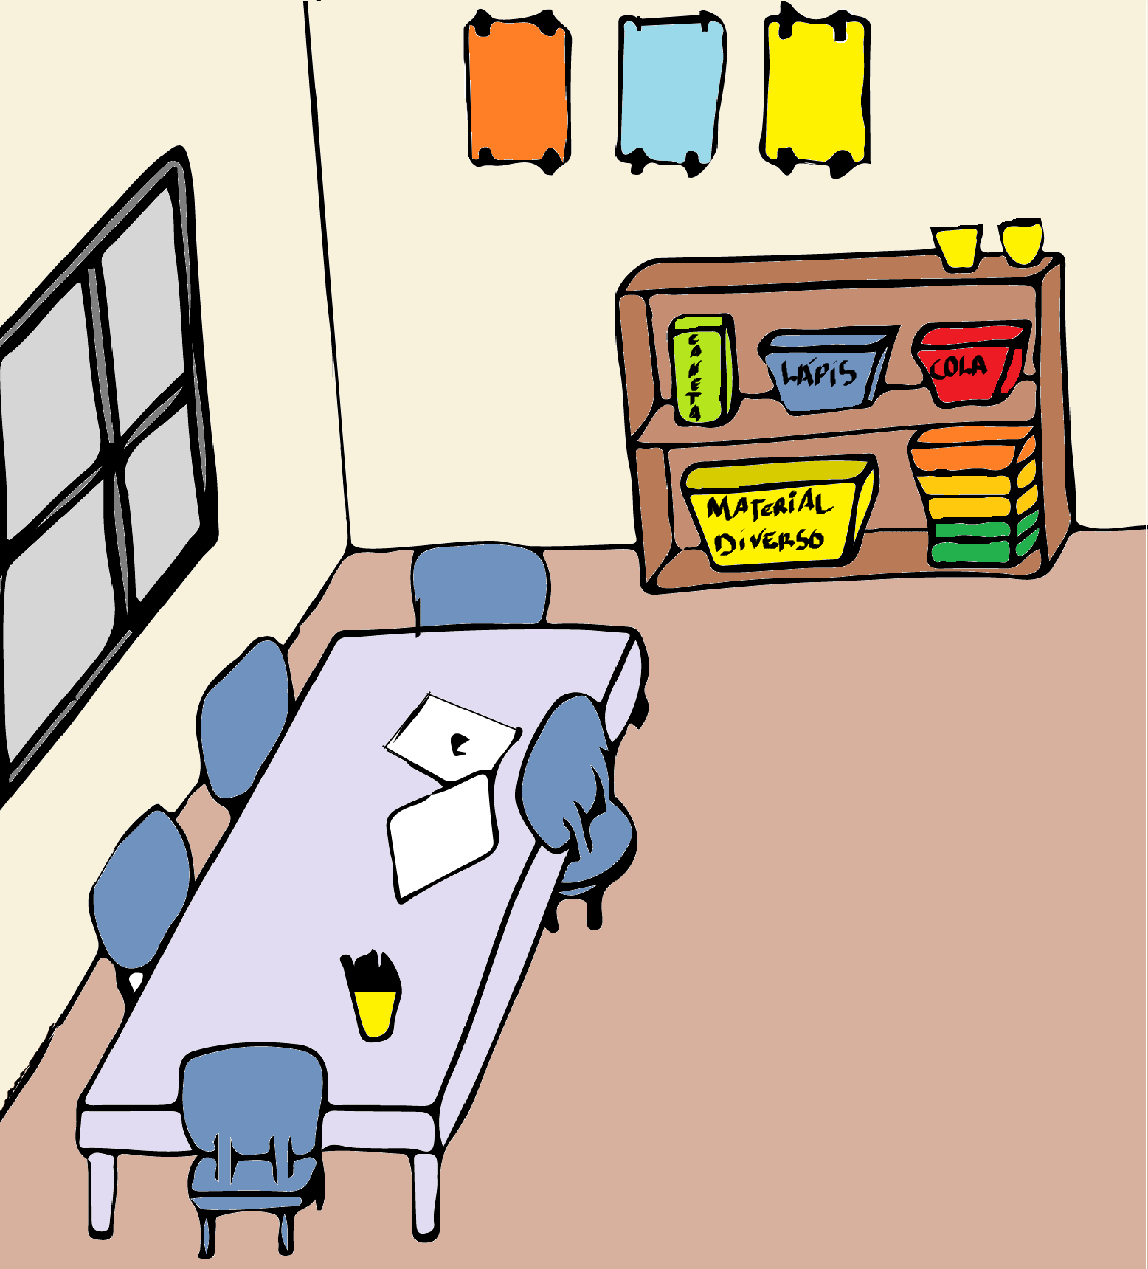
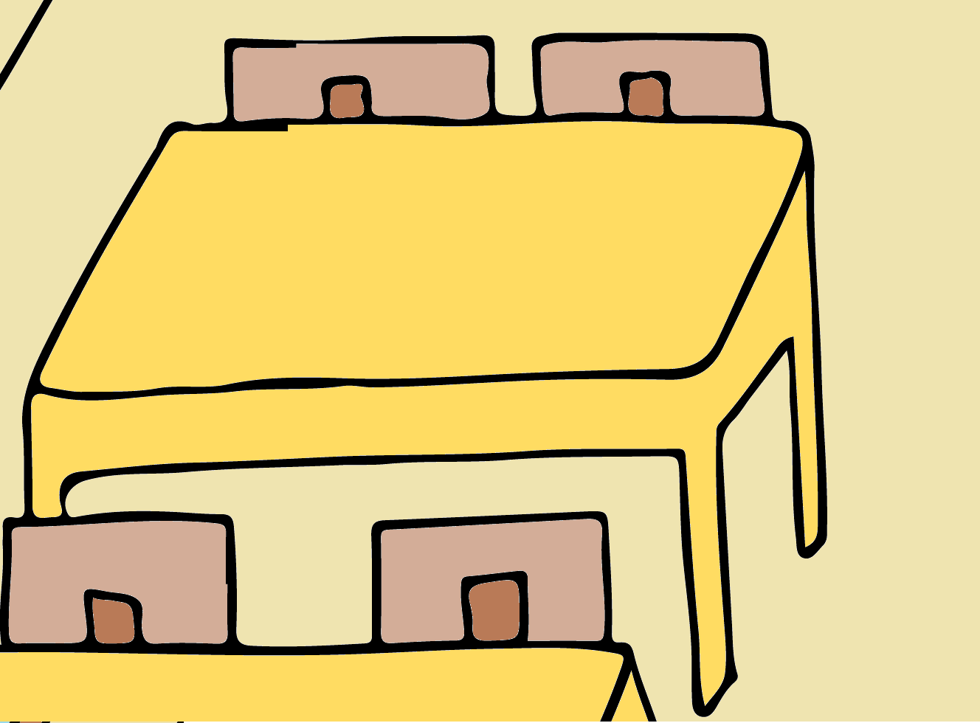
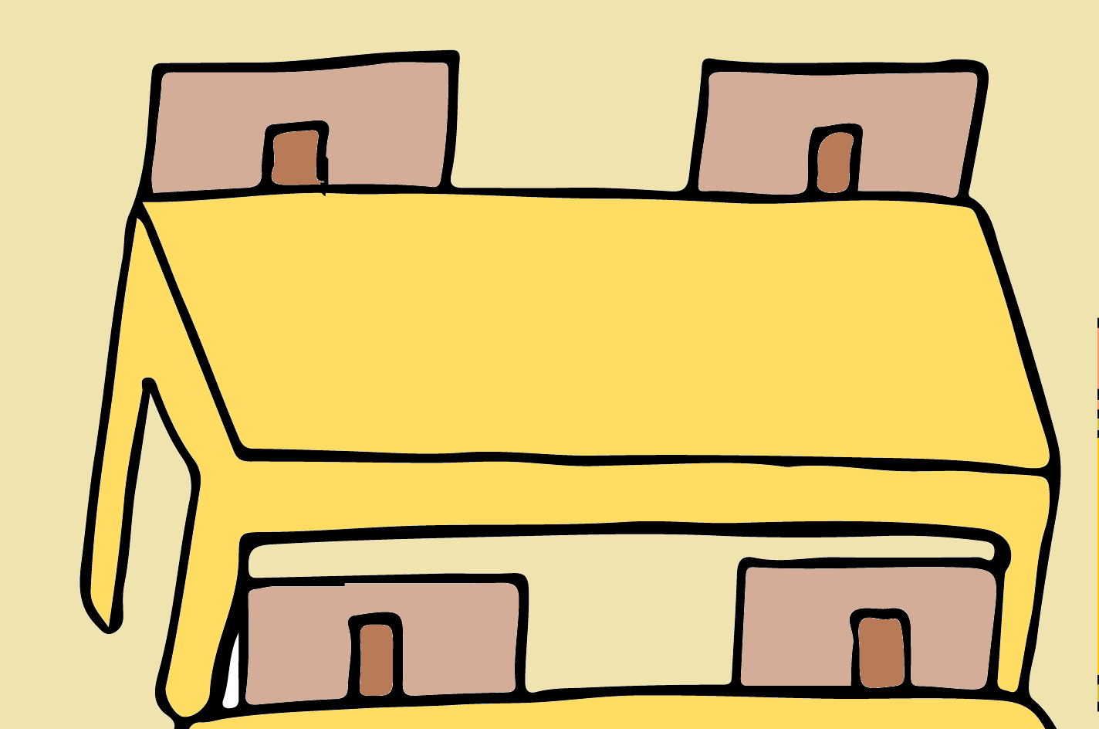
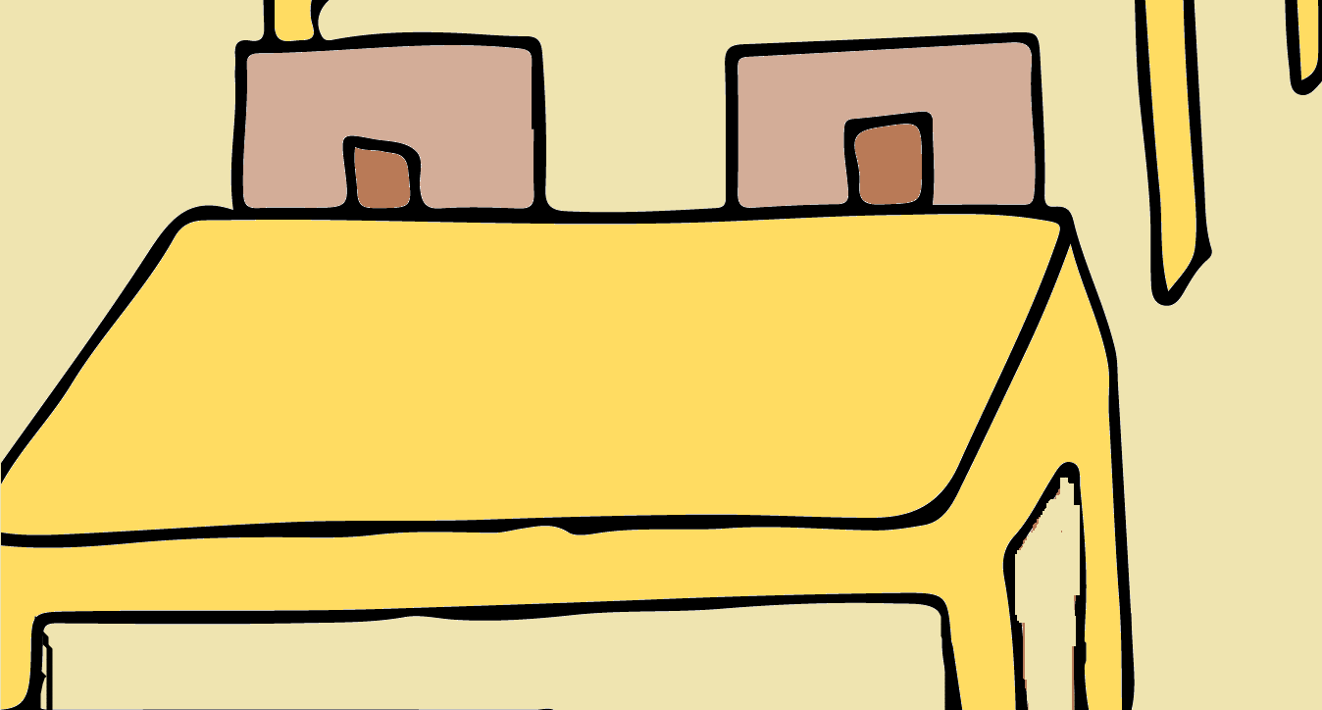

Slide 17
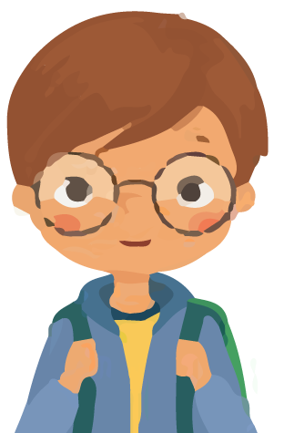
Yeah! You got it!
In the first grade classroom, everyone has their seats at their desks and that's where they're supposed to stay, during class...

Slide 18
4ºth Clue
In it we will sit, to work together!

Slide 19
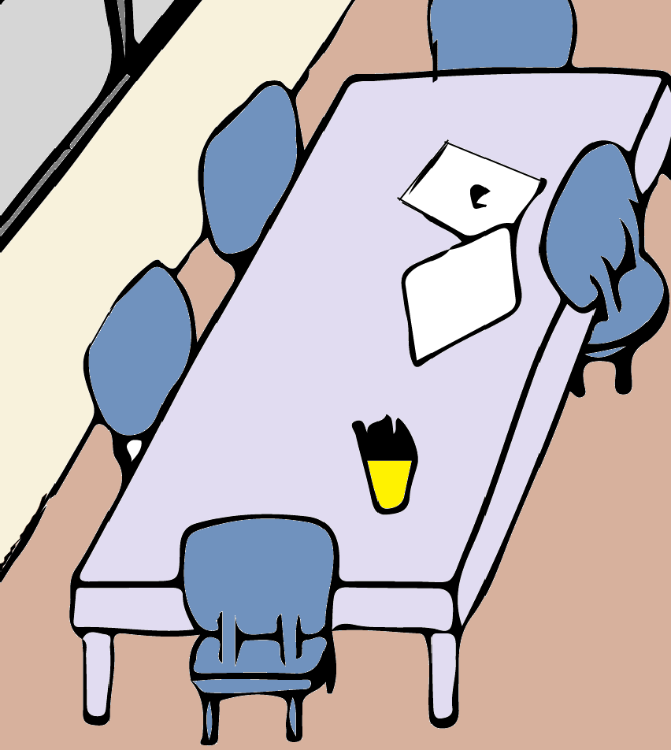

Slide 20
Yes... that's right!
In the orange room the table is longer and the kids sit down to do their jobs!
They can paint, draw, cut and make collages!

Slide 21
5ºth Clue
The materials he'll store, so that the backpacks won't support!

Slide 22
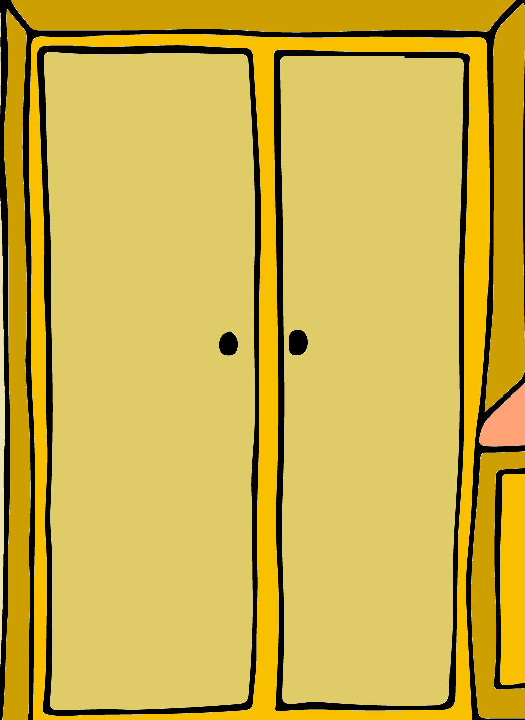

Slide 23
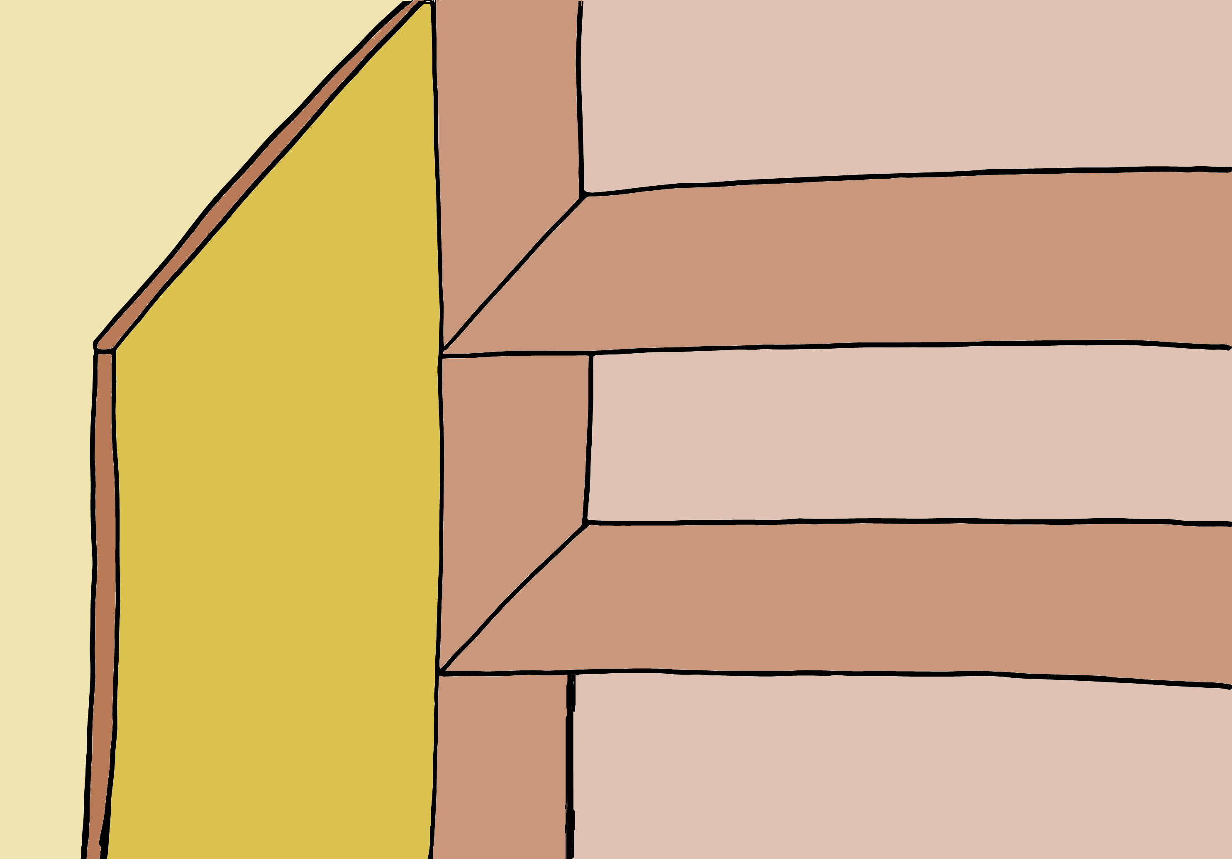
The closet...
In this closet we keep all the books, of Portuguese, math, Natural Sciences, dictionaries and even the students' material boxes!
They stay here so that the backpacks are not always so heavy!

Slide 24
6ºth Clue!
In little boxes you will keep, the material you use, to work!

Slide 25
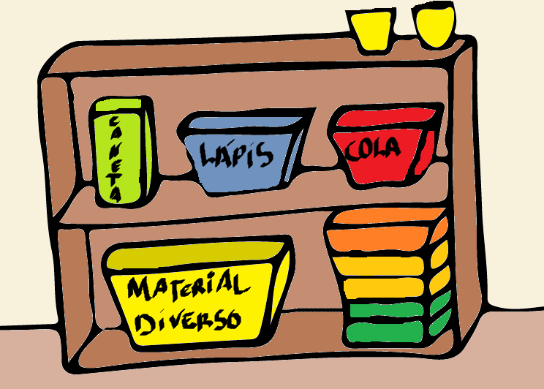

Slide 26
In the orange room closet are all the materials needed to do the work.
Pens, glues, scissors and paints are all stored in their boxes and all the students can use!

Slide 27
7ºth Clue
With games you will learn and thus consolidate your knowledge!

Slide 29
In the first year´s room we don't have a little house or garage, but in this closet we have some very cute games, which we use to learn!
We have fun too!

Slide 30
8ºth Clue
Here you'll cook, beautiful dishes to delight you!

Slide 31
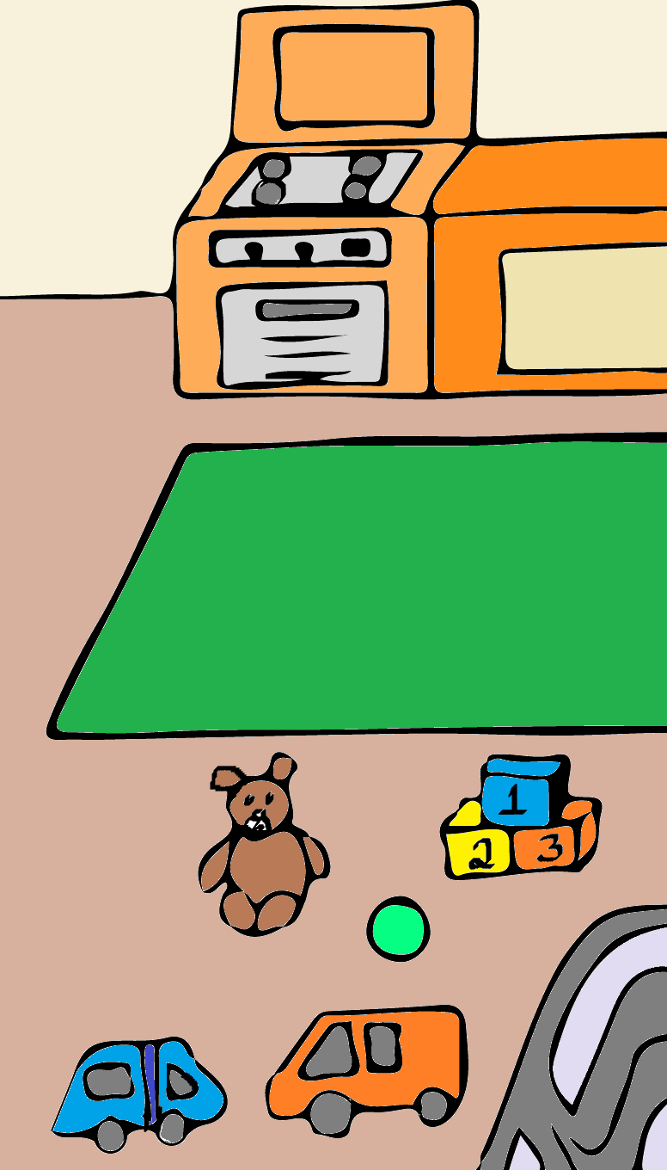

Slide 32
Yes...
In the orange room we have a little house and garage and other places to play!

Slide 33
9ºth Clue
Where are you going to put it?
It can't stay on the ground!

Slide 34
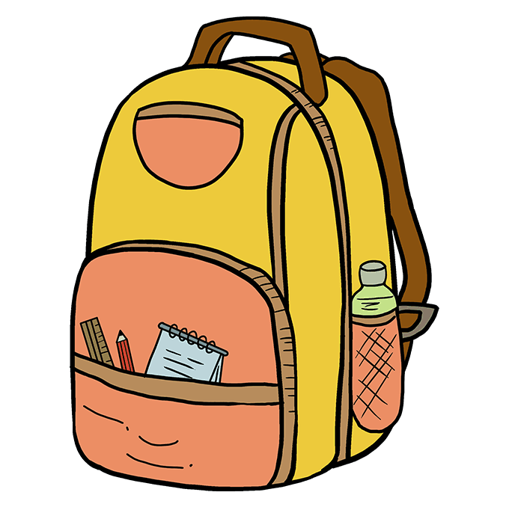

Slide 35
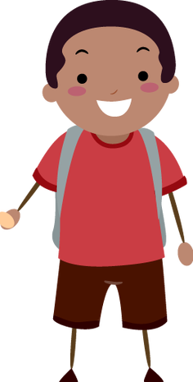
Here in the first year classroom, the students hang their coats and backpacks on the back of their chair or on the hangers outside the room!

Slide 36
10ºth Clue
When you get your coat, you're gonna hang it up and then go play!

Slide 37
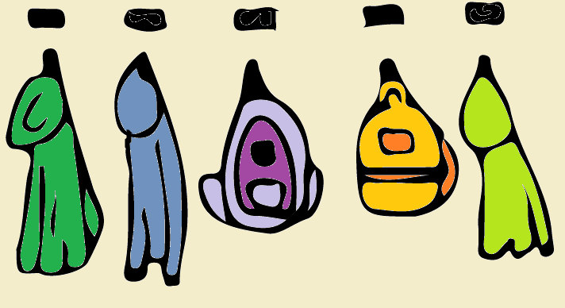

Slide 38
In the orange room the students hang their coats and backpacks inside the room, in their names...

Slide 39
Congratulations!
You got all the differences right!
The two rooms are different but they have something in common, YOU!
And that's without a doubt the most important thing!

